Slide 1


How a different ant behavior affects on the performances of the whole colony
C. Crespi, G. Fargetta, R.A. Scollo, M.F. Pavone
Department of Mathematics and Computer Science, University of Catania

Slide 2
TALK OUTILE
INTRODUCTION
THE MODEL
EXPERIMENTS AND RESULTS
CONCLUSIONS

Slide 3
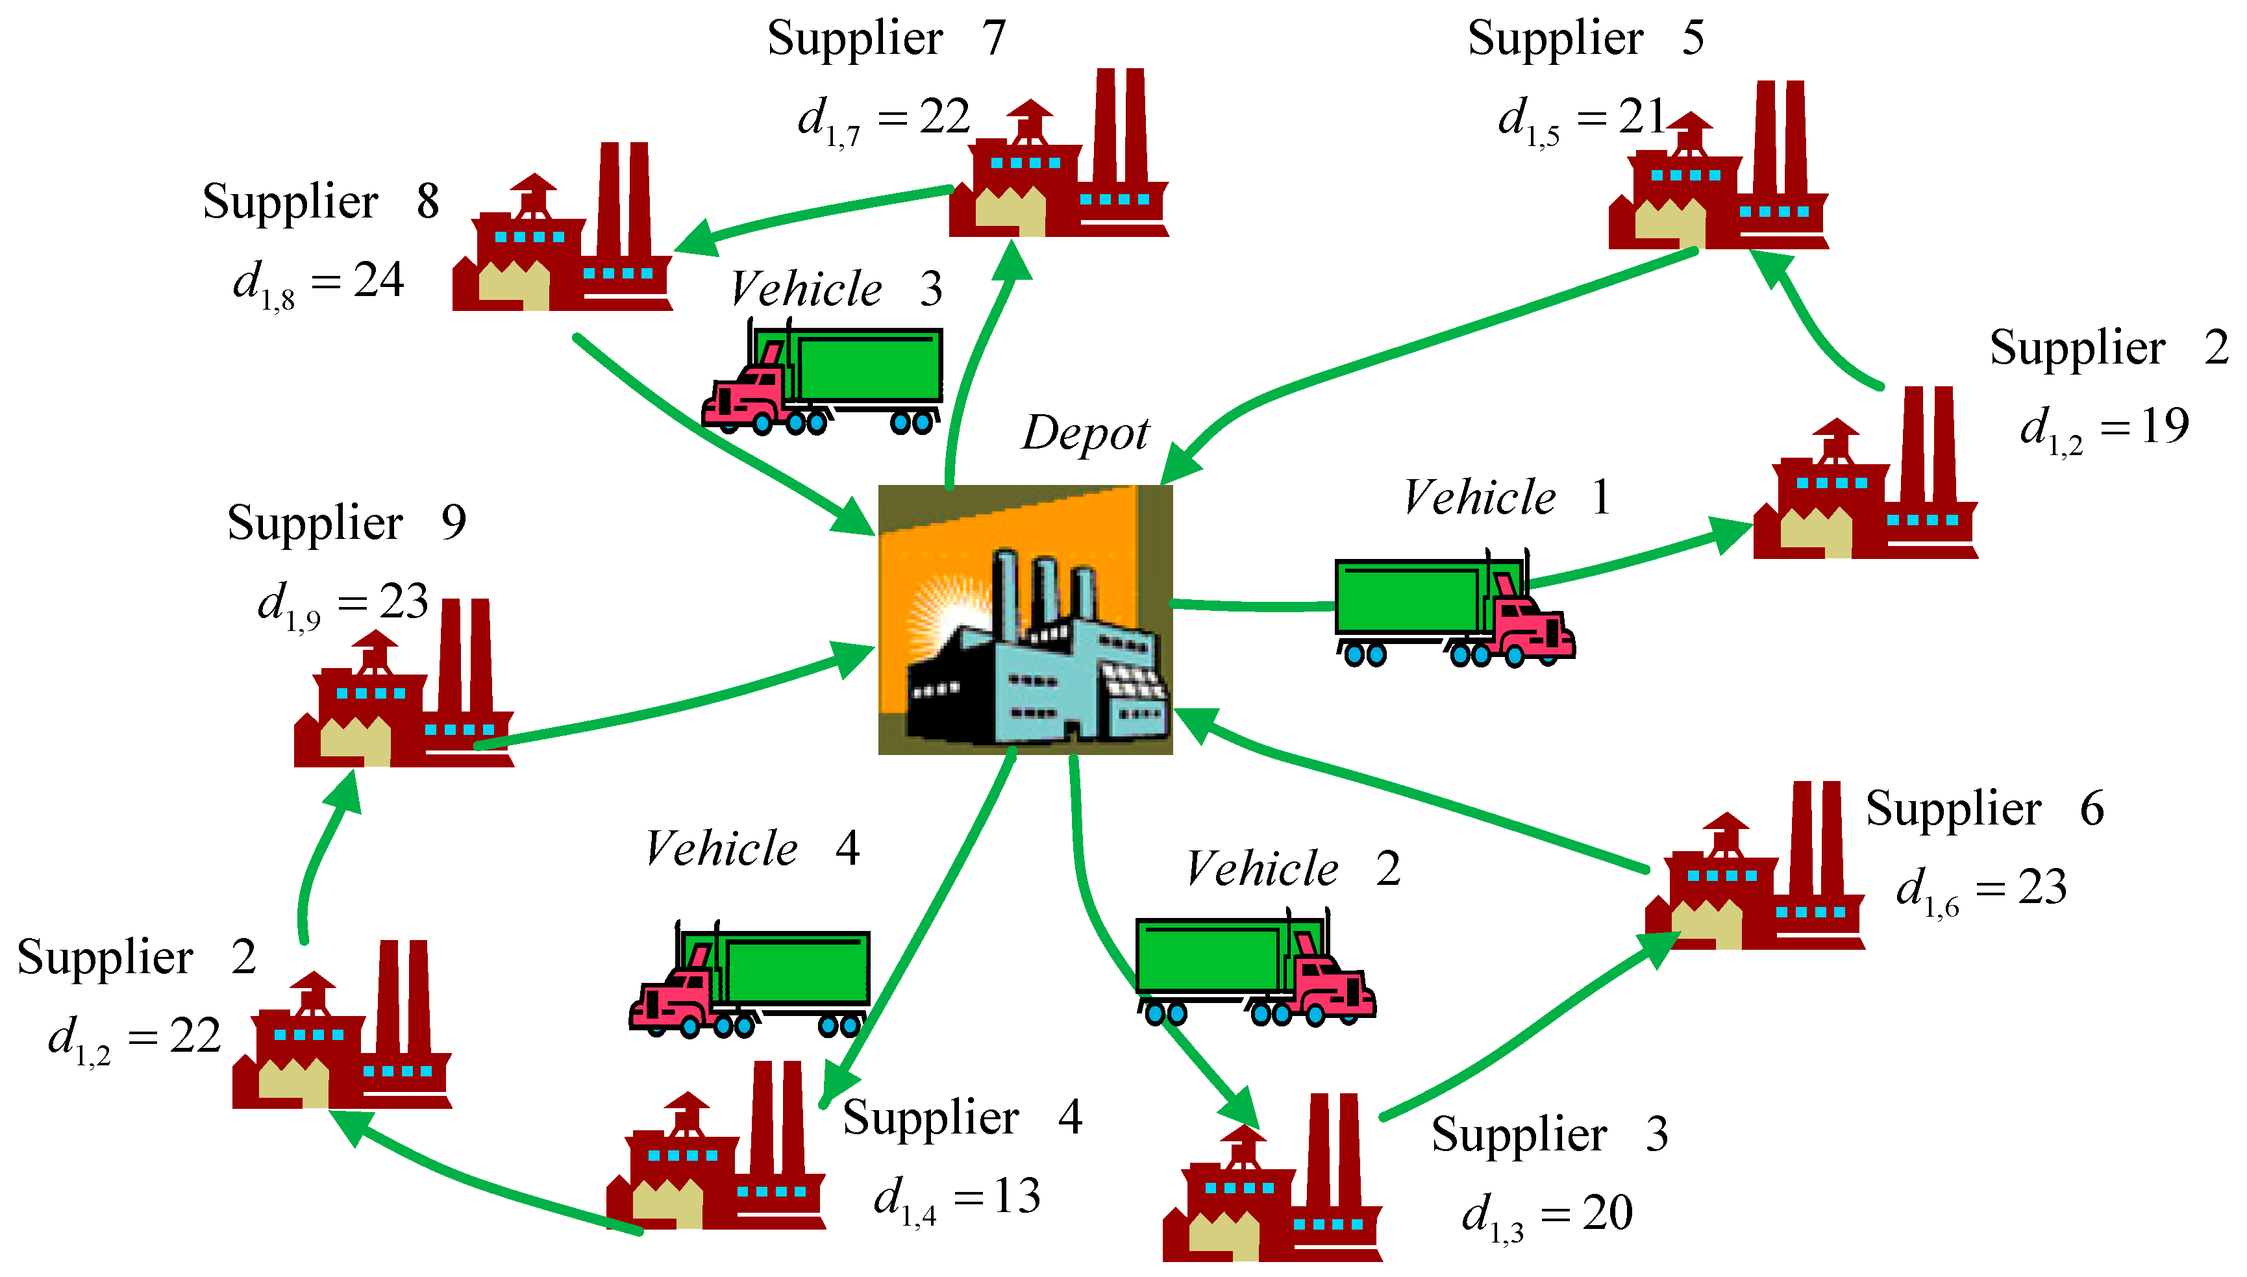
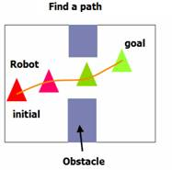
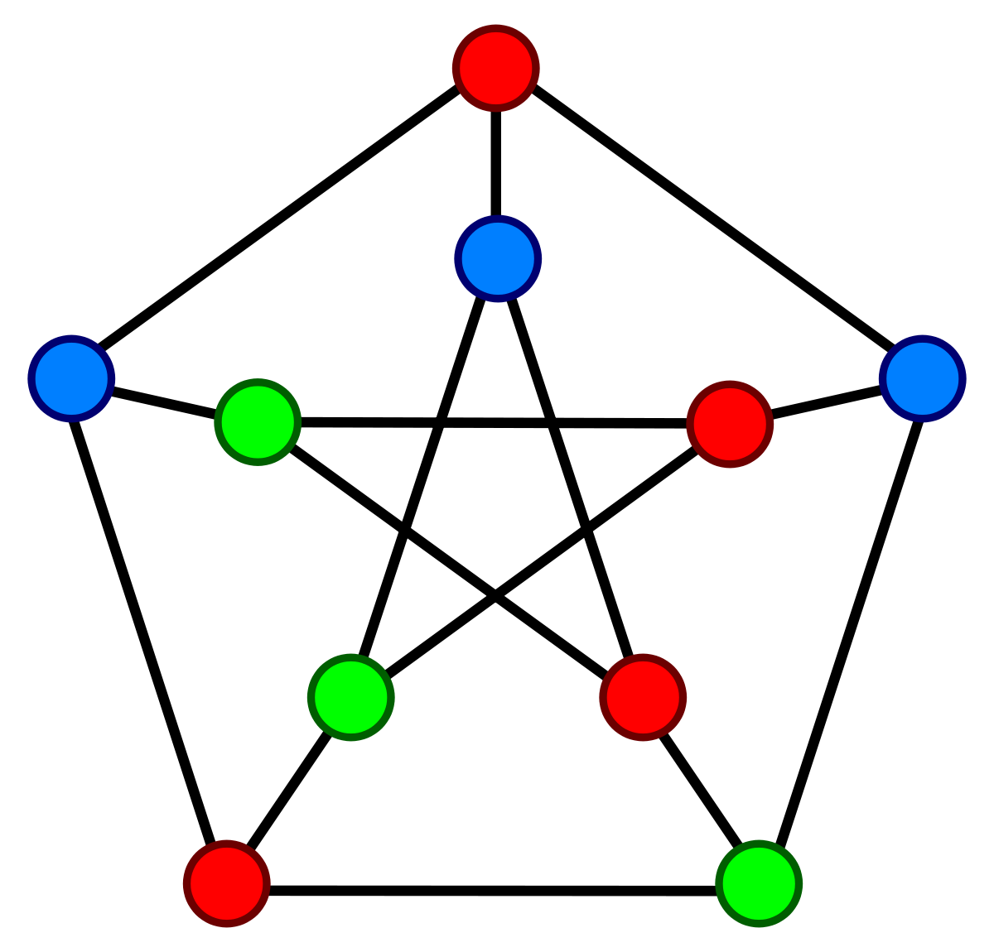
INTRODUCTION
Ant Colony Optimization (ACO) is a metaheuristic that takes inspiration from real ants, which can find the shortest path from their nest to a food source and communicate it to the rest of the colony using chemical signals called pheromones.
Thanks to these properties it has become a powerful optimization technique for solving different kinds of combinatorial optimization problems, such as:
scheduling and routing problems^{1,2};
coloring³;
robot path planning⁴;
feature selection⁵;
…many others…
1. Deng, W., Xu, J., Zhao, H.: An improved ant colony optimization algorithm based on hybrid strategies for scheduling problem. IEEE Access 7, 20281–20292 (2019).
2. Jia, Y.H., Mei, Y., Zhang, M.: A bilevel ant colony optimization algorithm for capacitated electric vehicle routing problem. IEEE Transactions on Cybernetics pp. 1–14 (2021)
3. Consoli, P., Collerà, A., Pavone, M.: Swarm intelligence heuristics for graph coloring problem. In: 2013 IEEE Congress on Evolutionary Computation. pp. 1909–1916 (2013).
4. Zhang, D., You, X., Liu, S., Pan, H.: Dynamic multi-role adaptive collaborative ant colony optimization for robot path planning. IEEE Access 8, 129958–129974 (2020)
5. Peng, H., Ying, C., Tan, S., Hu, B., Sun, Z.: An improved feature selection algorithm based on ant colony optimization. IEEE Access 6, 69203–69209 (2018)
1\13

Slide 4
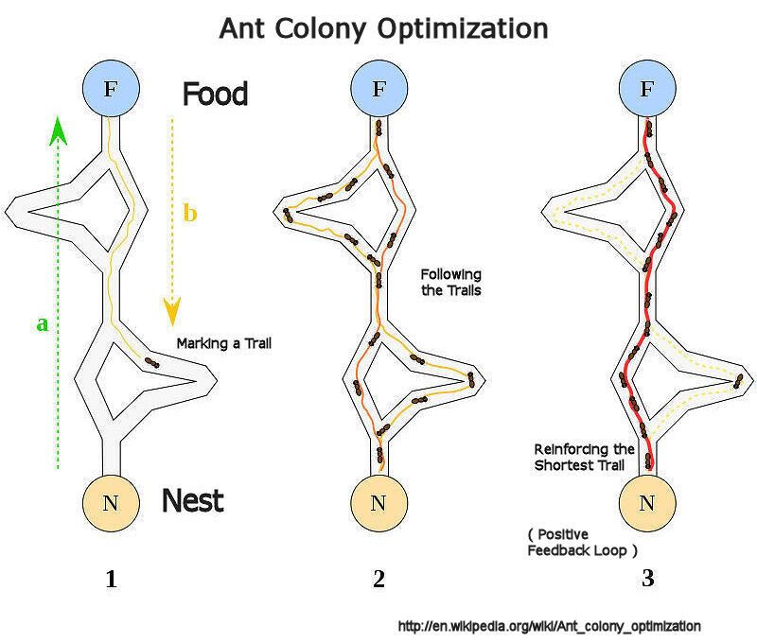

INTRODUCTION
ACO works because is not the single ant that finds the best solution, but its cooperation and interaction with the environment and the rest of the colony that produces the desired result. In light of this, a natural question arises:
What happens if, in a colony, some ants act in a different way from the others?
This question is the focus of our work.
2\13

Slide 5
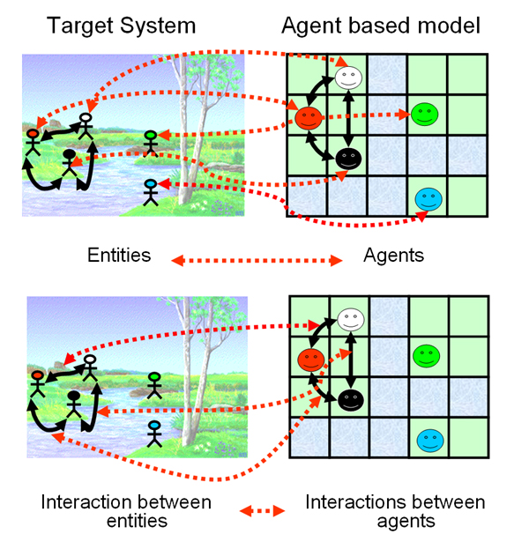
INTRODUCTION
To try to answer to this question, we have realized an agent-based model using NetLogo⁶, an agent-based programming language and an Integrated Development Environment (IDE). It consists of two different kinds of ants, with different behaviors, that move into a virtual environment to find a location (exit) from a starting point.
Their aim is:
finding the best path from the starting to the endpoint;
spending less time as possible to find it;
maximizing the number of ants that do it.
6. U. Wilensky, “Netlogo,” Center for Connected Learning and Computer-Based Modeling, Northwestern University, Evanston, IL, 1999. [Online].Available: http://ccl.northwestern.edu/netlogo/
3\13

Slide 6
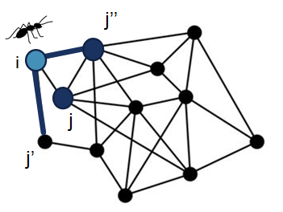
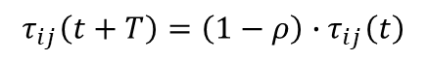
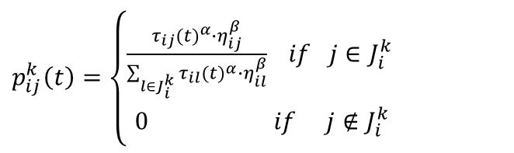
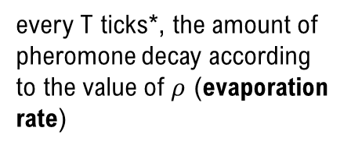
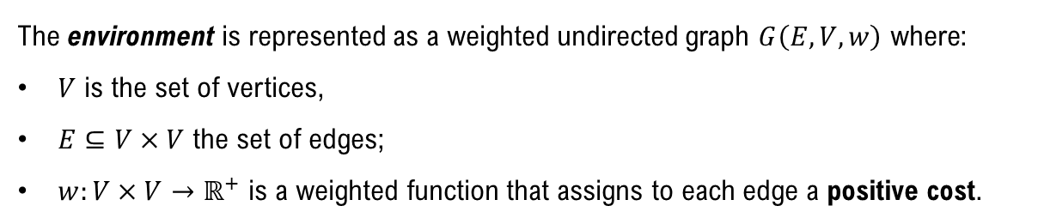
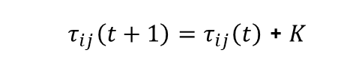
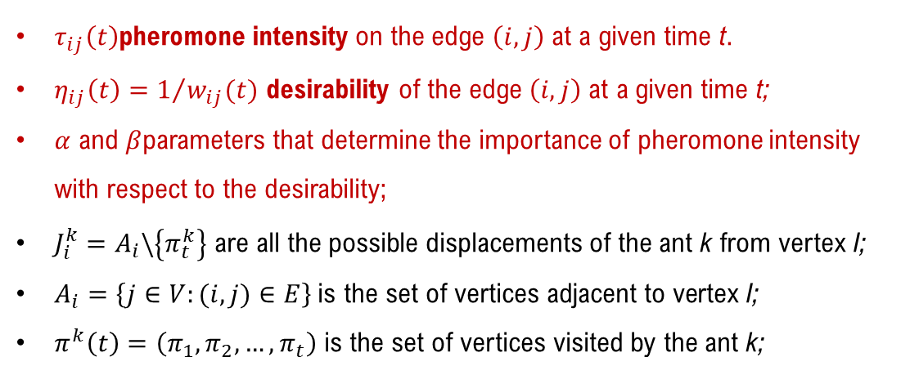
THE MODEL: ACO RULES
The environment is represented as a weighted undirected graph $G\left(E,V,w\right)$ where:
$V$ is the set of vertices,
$E⊆V×V$ the set of edges;
$w:V×V→ℝ^{+}$ is a weighted function that assigns to each edge a positive cost.
Proportional transition rule
Reinforcement rule
$p_{ij}^{k}\left(t\right)=\left\{\begin{aligned}\frac{τ_{ij}{(t)}^{α}∙η_{ij}^{β}}{\sum_{l∈J_{i}^{k}}{τ_{il}{(t)}^{α}∙η_{il}^{β}}} if j∈J_{i}^{k} \\ 0 if j∉J_{i}^{k}\end{aligned}\right.$
$τ_{ij}\left(t+1\right)=$ $τ_{ij}\left(t\right)$ + $K$
(2)
(1)
after an ant crosses a link, the pheromone is increased by a constant quantity K (user defined)
$τ_{ij}\left(t\right)$pheromone intensity on the edge $\left(i,j\right)$ at a given time t.
$η_{ij}\left(t\right)=1/{w_{ij}(t)}$ desirability of the edge $\left(i,j\right)$ at a given time t;
$α$ and $β$parameters that determine the importance of pheromone intensity with respect to the desirability;
$J_{i}^{k}=A_{i}\backslash \left\{π_{t}^{k}\right\}$ are all the possible displacements of the ant k from vertex I;
$A_{i}=\left\{j∈V:(i,j)∈E\right\} \text{is} \text{the} \text{set} \text{of} \text{vertices} \text{adjacent} \text{to} \text{vertex}$ I;
$π^{k}\left(t\right)=\left(π_{1},π_{2},…,π_{t}\right)$ is the set of vertices visited by the ant k;
Global updating rule
$$τ_{ij}\left(t+T\right)=\left(1−ρ\right)∙τ_{ij}\left(t\right)$$
(3)
every T ticks*, the amount of pheromone decay according to the value of $ρ$ (evaporation rate)
*The time unit used that corresponds to a single movement of all agents.
4\13

Slide 7
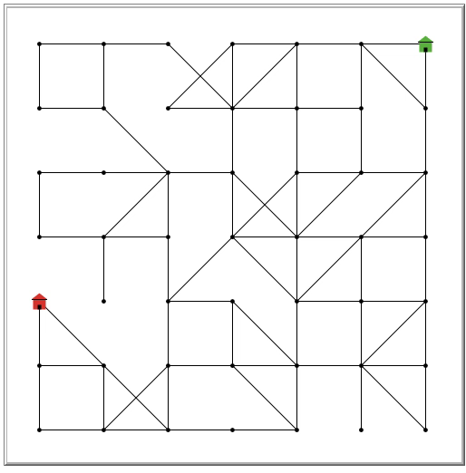
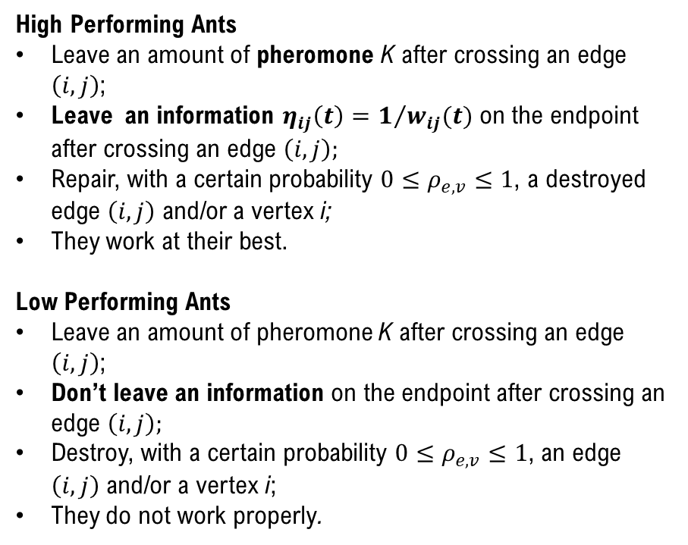
THE MODEL
Two kinds of ants
Endpoint
High Performing Ants
Leave an amount of pheromone K after crossing an edge $\left(i,j\right)$;
Leave an information $η_{ij}\left(t\right)=1/{w_{ij}(t)}$ on the endpoint after crossing an edge $\left(i,j\right);$
Repair, with a certain probability $0≤ρ_{e,v}≤1$, a destroyed edge $\left(i,j\right)$ and/or a vertex i;
They work at their best.
Low Performing Ants
Leave an amount of pheromone K after crossing an edge $\left(i,j\right)$;
Don’t leave an information on the endpoint after crossing an edge $\left(i,j\right);$
Destroy, with a certain probability $0≤ρ_{e,v}≤1$, an edge $\left(i,j\right)$ and/or a vertex i;
They do not work properly.
Starting point
5\13

Slide 8
THE MODEL
The problem under investigation can be considered as a general path problem but the shortest path, in this case, is not a good evaluation metric because:
The destroy\repair actions make the network dynamic;
A node or a link can be not crossable in the timestep t, but becoming crossable later.
t = 0
t + 1
t + n
6\13

Slide 9
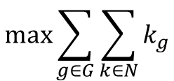
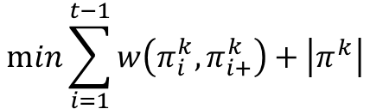
THE MODEL
Good evaluation metrics are:
Exit function
must be maximized
Path cost and resolution time functions must be minimized
$$\max{\sum_{g∈G}{\sum_{k∈N}{k_{g}}}}$$
$$\min{\sum_{i=1}^{t−1}{w\left(π_{i}^{k},π_{i+}^{k}\right)+\left|π^{k}\right|}}$$
(5)
(4)
path made by an ant k
n° steps made by ant k
G number of groups;
g index of the group to which the ant k belongs;
k_{g} ant k that belongs to g group;
N set of ants.
It can be used also as a time term because each unit of time corresponds to an ant displacement.
the number of nodes visited by an ant corresponds to the resolution time.
7\13

Slide 10
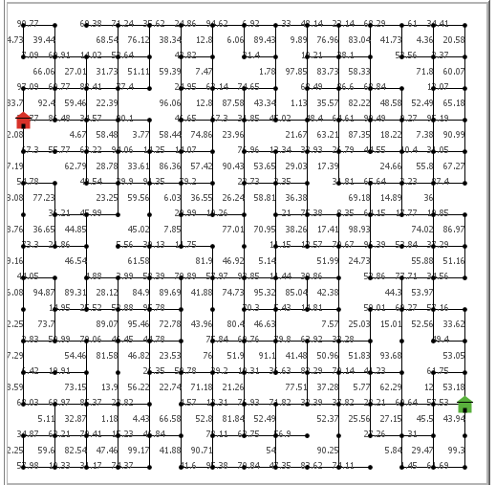
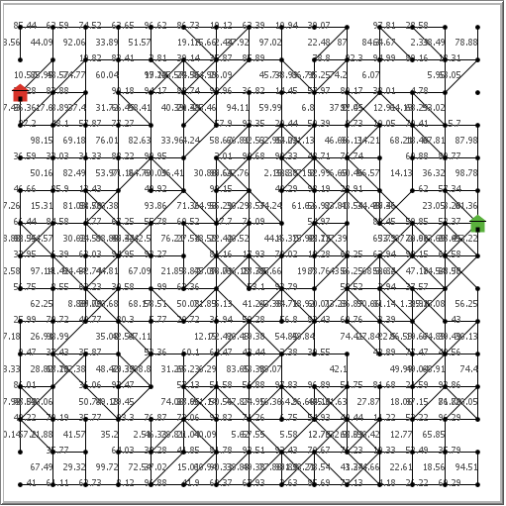
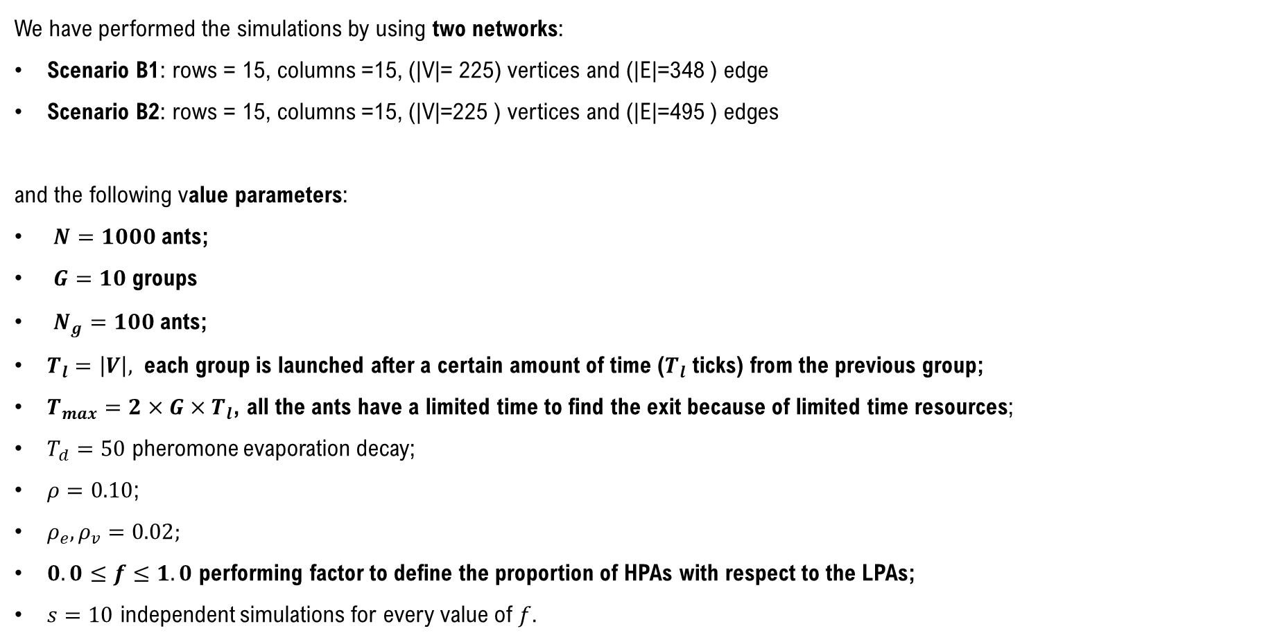
EXPERIMENTS AND RESULTS
We have performed the simulations by using two networks:
Scenario B1: rows = 15, columns =15, (|V|= 225) vertices and (|E|=348 ) edge
Scenario B2: rows = 15, columns =15, (|V|=225 ) vertices and (|E|=495 ) edges
and the following value parameters:
$N=1000$ants;
$G=10$ groups
$N_{g}=100$ants;
$T_{l}=\left|V\right|,$ each group is launched after a certain amount of time ($T_{l}$ ticks) from the previous group;
$T_{max}=2×G×T_{l}$, all the ants have a limited time to find the exit because of limited time resources;
$T_{d}=50$ pheromone evaporation decay;
$ρ=0.10$;
$ρ_{e},ρ_{v}=0.02;$
$0.0≤f≤1.0$ performing factor to define the proportion of HPAs with respect to the LPAs;
$s=10$ independent simulations for every value of $f$.
B1
B2
8\13

Slide 11
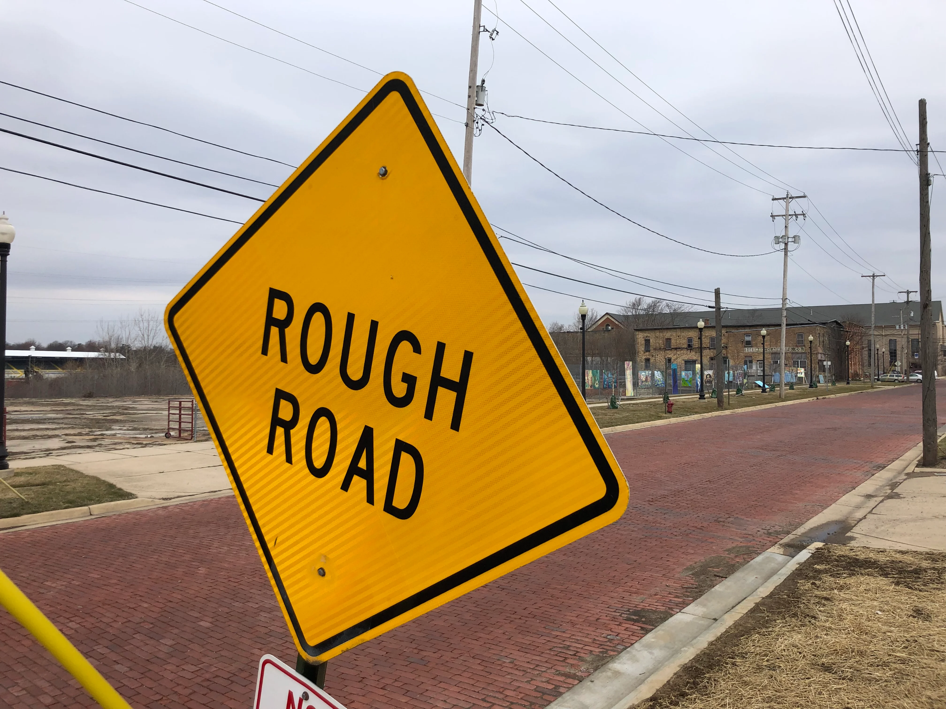

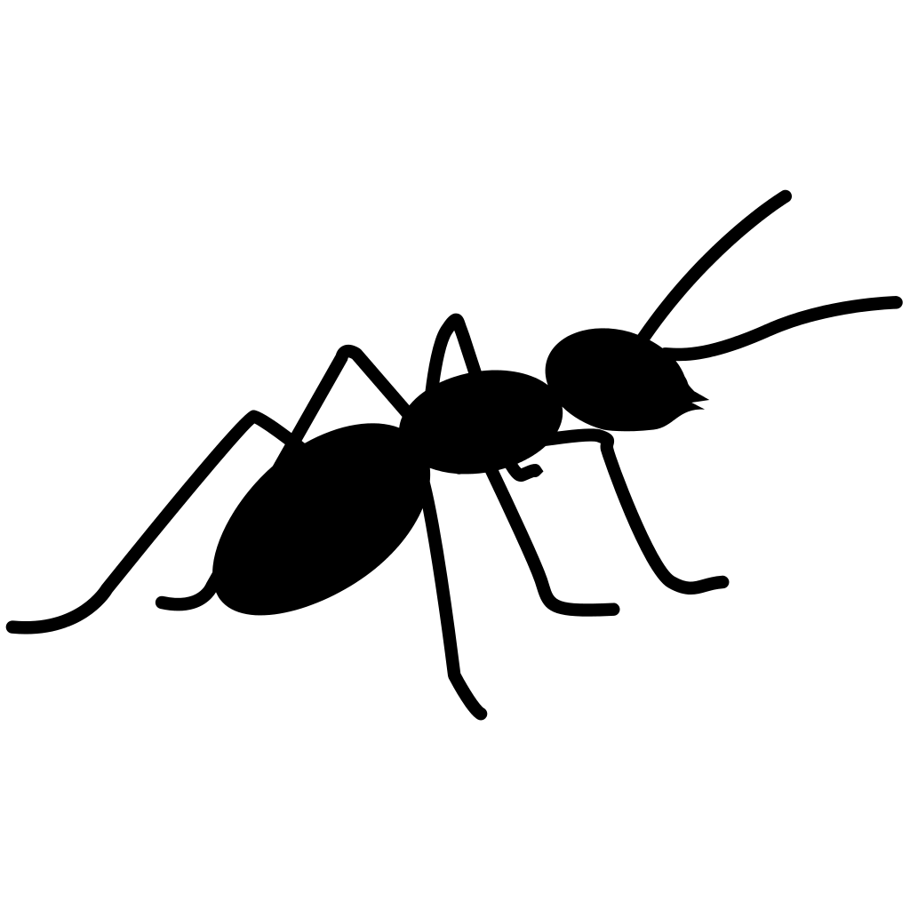

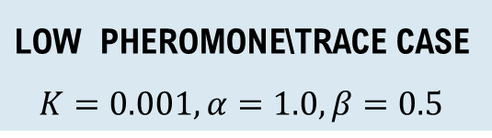
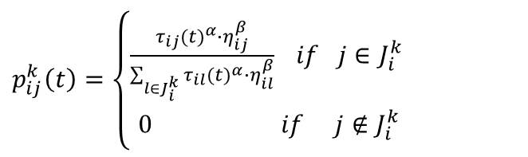
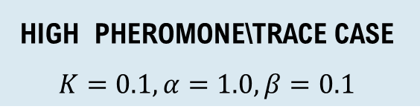
EXPERIMENTS AND RESULTS
We have considered the following cases:
$$\text{LOW} \text{PHEROMONE}\text{\backslash }\text{TRACE} \text{CASE}$$
$K=0.001, α=1.0, β=0.5$
$p_{ij}^{k}\left(t\right)=\left\{\begin{aligned}\frac{τ_{ij}{(t)}^{α}∙η_{ij}^{β}}{\sum_{l∈J_{i}^{k}}{τ_{il}{(t)}^{α}∙η_{il}^{β}}} if j∈J_{i}^{k} \\ 0 if j∉J_{i}^{k}\end{aligned}\right.$
$$\text{HIGH} \text{PHEROMONE}\text{\backslash }\text{TRACE} \text{CASE}$$
$K=0.1, α=1.0, β=0.1$
(1)
Objective information
Objective information
trace\pheromone
trace\pheromone
9\13

Slide 12
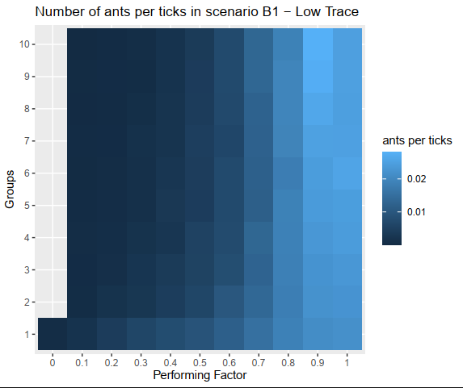
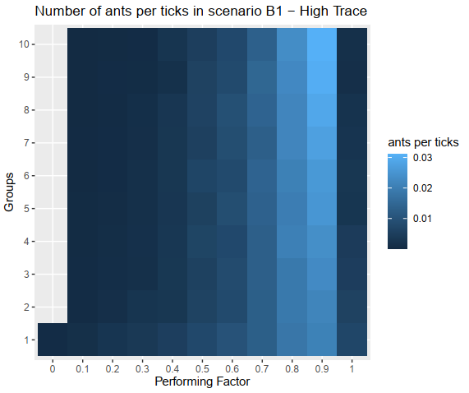
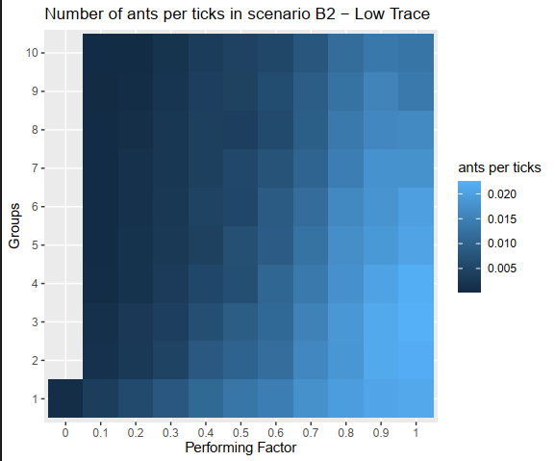
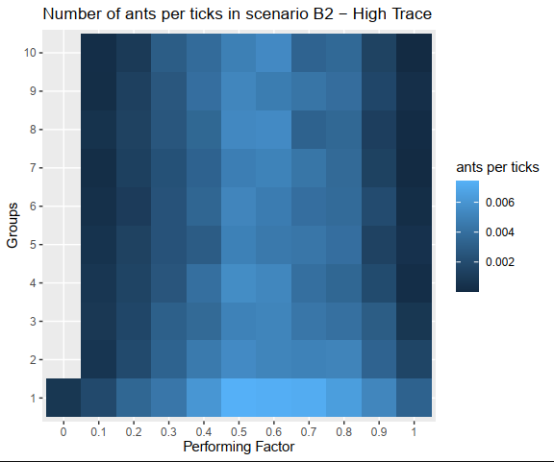
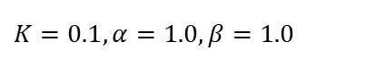
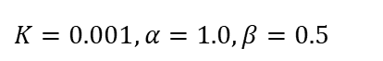
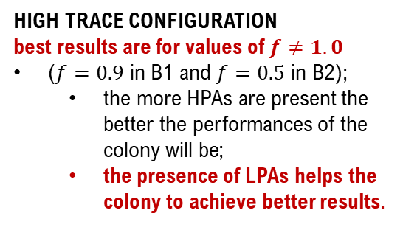
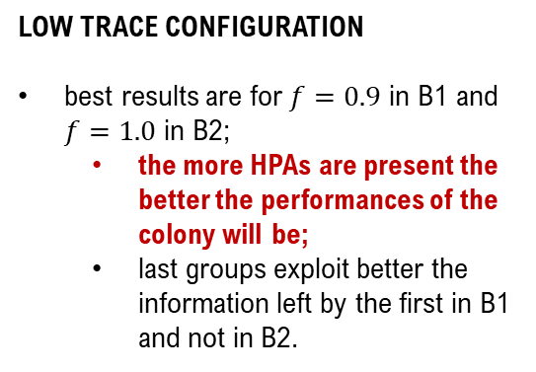
EXPERIMENTS AND RESULTS: GROUP ANALYSIS
Heat map plots
x-axis: performing factor
y-axis: groups
legend: the lighter the blue is the higher the value of the number of ants is, and vice versa.
absence of colour: no ants have reached the exit.
LOW TRACE CONFIGURATION
best results are for $f=0.9$ in B1 and $f=1.0$ in B2;
the more HPAs are present the better the performances of the colony will be;
last groups exploit better the information left by the first in B1 and not in B2.
ACO
ACO
HIGH TRACE CONFIGURATION
best results are for values of $f≠1.0$
($f=0.9$ in B1 and $f=0.5$ in B2);
the more HPAs are present the better the performances of the colony will be;
the presence of LPAs helps the colony to achieve better results.
ACO
ACO
$K=0.001, α=1.0, β=0.5$
$K=0.1, α=1.0, β=1.0$
10\13

Slide 13
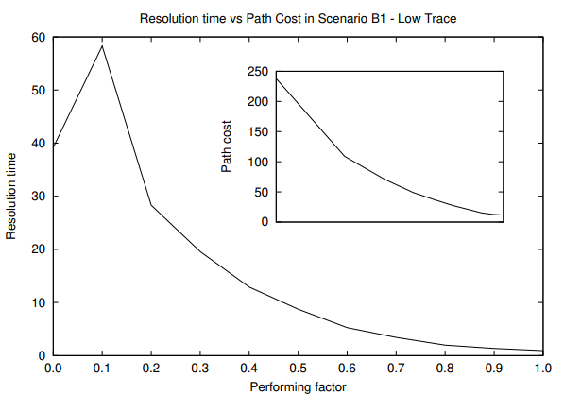
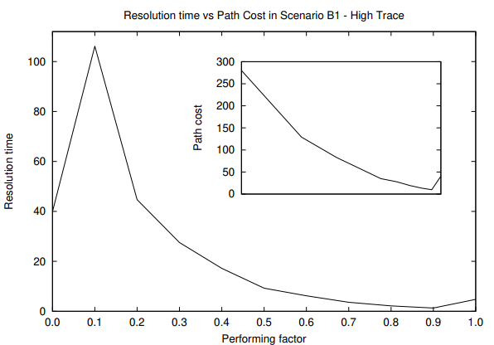
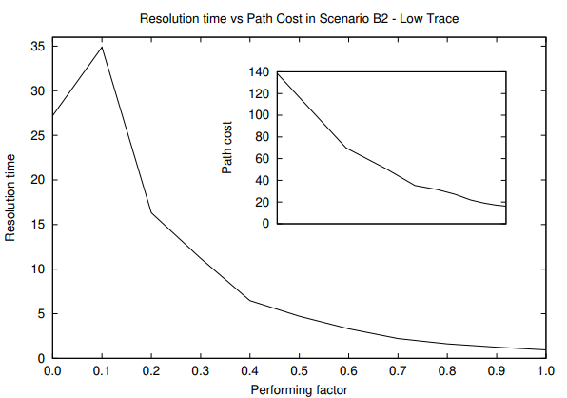
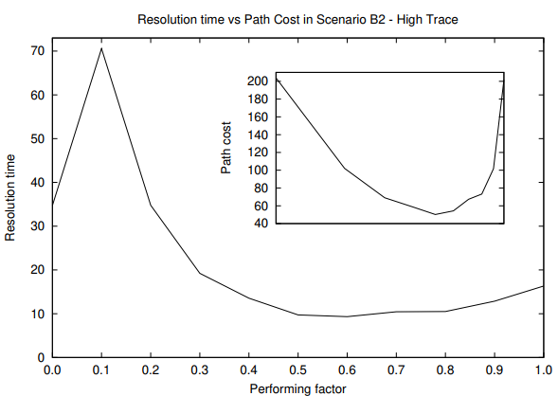
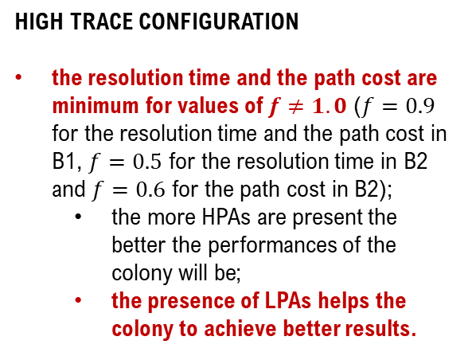
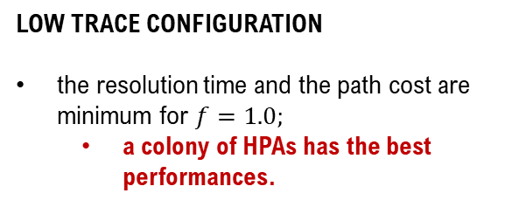
EXPERIMENTS AND RESULTS: OVERALL ANALYSIS – PATH COST AND RESOLUTION TIME
Plots and inset plots (5)
x-axis: performing factor
y-axis: resolution time\path cost
LOW TRACE CONFIGURATION
the resolution time and the path cost are minimum for $f=1.0;$
a colony of HPAs has the best performances.
ACO
ACO
HIGH TRACE CONFIGURATION
the resolution time and the path cost are minimum for values of $f≠1.0$ ($f=0.9$ for the resolution time and the path cost in B1, $f=0.5$ for the resolution time in B2 and $f=0.6$ for the path cost in B2);
the more HPAs are present the better the performances of the colony will be;
the presence of LPAs helps the colony to achieve better results.
ACO
ACO
$K=0.001, α=1.0, β=0.5$
$K=0.1, α=1.0, β=1.0$
11\13

Slide 14
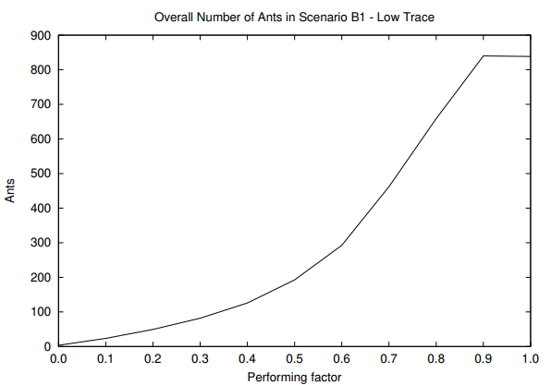
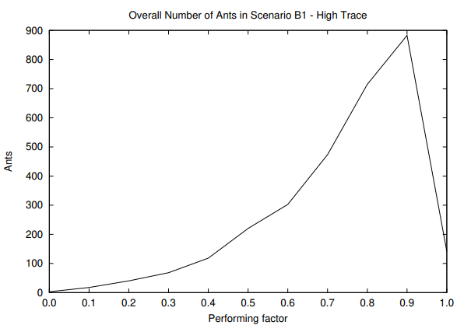
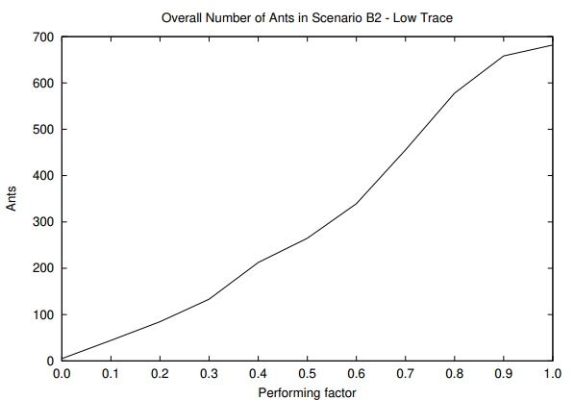
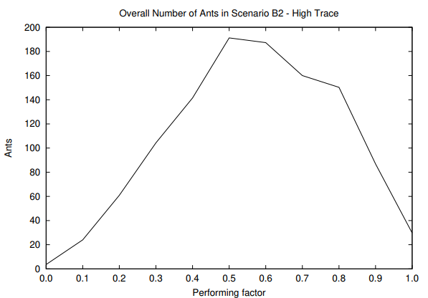
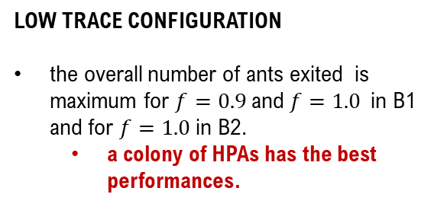
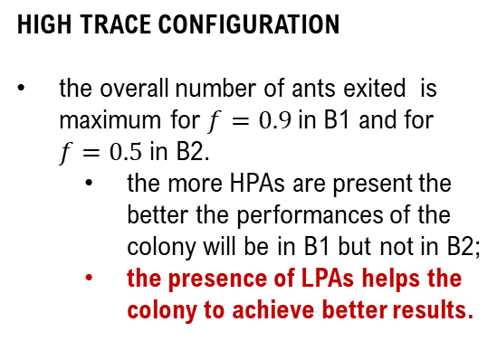
EXPERIMENTS AND RESULTS: OVERALL ANALYSIS – EXITED ANTS
Plots (4)
x-axis: performing factor
y-axis: number of ants
LOW TRACE CONFIGURATION
the overall number of ants exited is maximum for $f=0.9$and $f=1.0$in B1 and for $f=1.0$in B2.
a colony of HPAs has the best performances.
ACO
ACO
HIGH TRACE CONFIGURATION
the overall number of ants exited is maximum for $f=0.9$in B1 and for $f=0.5$in B2.
the more HPAs are present the better the performances of the colony will be in B1 but not in B2;
the presence of LPAs helps the colony to achieve better results.
ACO
ACO
$K=0.001, α=1.0, β=0.5$
$K=0.1, α=1.0, β=1.0$
12\13

Slide 15
CONCLUSIONS AND FUTURE WORKS
From data analysis, emerges that:
the presence of ants with different behaviours (LPAs) is useful when there is a condition of high-level trace;
the actions performed by the LPAs (destroy nodes and\or links) stimulate the rest of the colony to search for other paths;
an excess of trace is self-defeating for the ants.
Future works:
simulations on network with more complex topology;
simulations with different values parameters;
tests on real combinatorial optimization problems.
13\13

Slide 16
C. Crespi
carolina.crespi@phd.unict.it
G. Fargetta
georgia.fargetta@phd.unict.it
R.A. Scollo
rocco.scollo@phd.unict.it
M.F. Pavone
mpavone@dmi.unict.it
Department of Mathematics and Computer Science, University of Catania
THANKS FOR YOUR ATTENTION
ANY QUESTIONS?

